Slide 1
Women’s Health
Pregnancy

Slide 2
Contraception

Slide 3
Contraception
Birth control allows us to prevent pregnancy and plan the timing of pregnancy
Natural Methods
Hormonal Methods
Barrier Methods
Permanent Methods

Slide 4
Natural Methods
Methods not involving hormones or surgery
Abstinence
Outercourse
Withdrawal Method
Breastfeeding
Fertility Awareness-Based Method

Slide 5
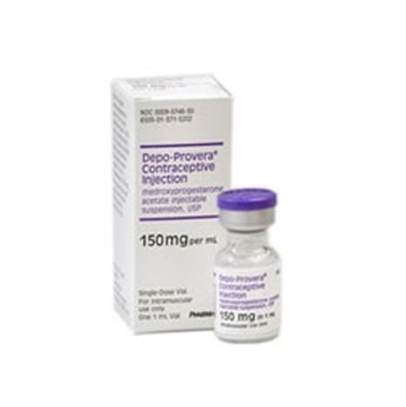
Hormonal Methods
Release hormones that keep eggs from leaving ovaries
Make cervical mucus thicker preventing sperm from getting to the eggs

Slide 6
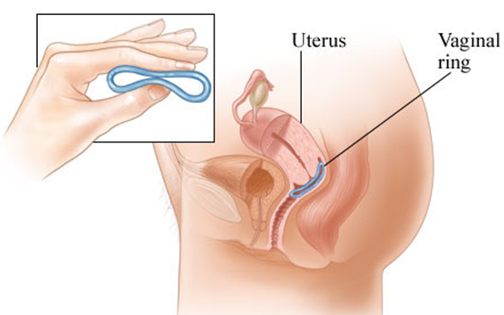
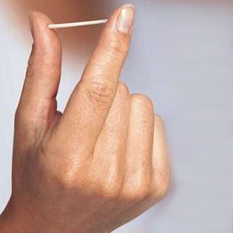
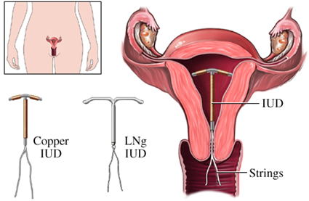
Hormonal Methods
Birth Control Vaginal Ring
Birth Control Implant
Birth Control Patch
Birth Control Pill
Birth Control Shot
Morning-After Pill
IUD

Slide 7
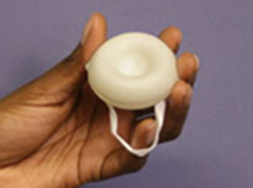
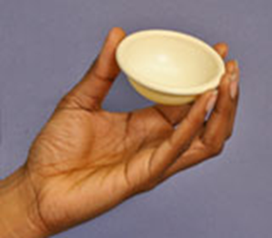
Barrier Methods
Physically block sperm from fertilizing eggs
Male Condom
Female Condom
Birth Control Sponge
Diaphragm

Slide 8
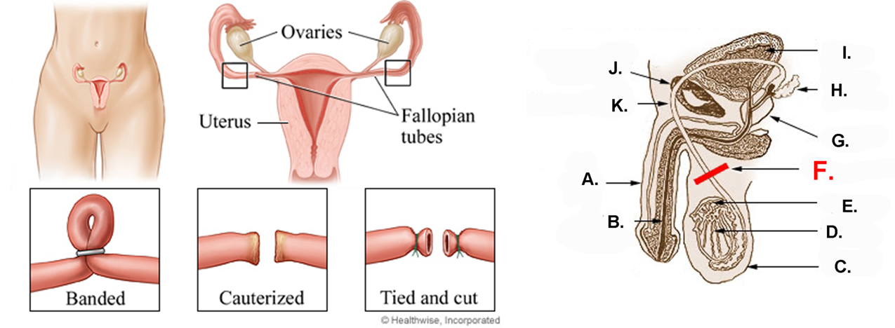
Surgical Method
A permanent solution performed by a physician to prevent future pregnancy
Vasectomy
Sterilization

Slide 10
Prenatal Care

Slide 11
What is prenatal care?
Extra care during pregnancy to ensure health and prevent complications
Appointments typically include:
A physical exam (including weight and blood pressure checks)
A pelvic exam
A urine sample
A blood test
Ultrasounds (routinely beginning ~20 wks.)

Slide 12
Why is prenatal care so important?
It reduces the risk of complications both during pregnancy and during labor
Can detect any issues that a woman may have early enough to address them
The healthier a woman is during pregnancy, the healthier the baby will be
Can provide a lot of information about what is and isn’t safe/healthy during pregnancy beyond the basics
Some supplements and medicines aren’t safe to take during pregnancy, and other supplements like folic acid are very important to take
Certain activities cease to be safe at certain points in pregnancy (ex. flying)
Exercise can be great to improve health during pregnancy, but only to a certain extent

Slide 13
How to get prenatal care?
It’s important to start receiving prenatal care by early in the second trimester
Can either see a primary care physician or an OB/GYN
Better to see an OB/GYN for a high risk pregnancy
Medicaid covers costs of prenatal care through pregnancy, labor, and delivery
Call Cincinnati Health Department for reduced cost prenatal care options

Slide 14
Complications of Pregnancy

Slide 15
Gestational Diabetes
Pregnant women who have never had a history of diabetes, who have high blood glucose levels during pregnancy
Sometimes can cause diabetes after pregnancy is over

Slide 16
Gestational Diabetes
Maternal Risks:
Hydramnios (extra fluid surrounding the fetus)
Preeclampsia
Eclampsia
Increased susceptibility for infection
Fetal and Neonatal Risks:
Prenatal mortality
Congenital abnormalities
Respiratory Distress Syndrome (RDS)
Intrauterine growth restriction (IUGR)
Hypocalcaemia
Hypoglycemia after birth

Slide 17
Gestational Diabetes
Treatment
Diet therapy and exercise
Glucose monitoring
Insulin therapy

Slide 18
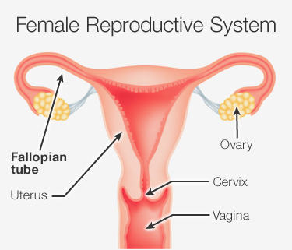
Ectopic Pregnancy
When a fertilized egg stays in the fallopian tube
Occurs in 1 out of every 50 pregnancies
Very dangerous and require emergency treatment
Very rare that the infant will survive

Slide 19
Ectopic Pregnancy
Risks:
Tubal damage
Pervious pelvic, tubal surgery, previous ectopic
High levels of progesterone
Primary infertility
Smoking
Advanced maternal age

Slide 20
Preeclampsia
When a pregnant woman develops high blood pressure and proteins levels
Occurs in 5% of pregnancies
Usually starts about 20 weeks after pregnancy
Preeclampsia can lead to a condition known as eclampsia in which seizures occur.

Slide 21
Preeclampsia
Fetal risks:
Placental abruption
Poor growth
Too little amniotic fluid
Premature birth

